Slide 1


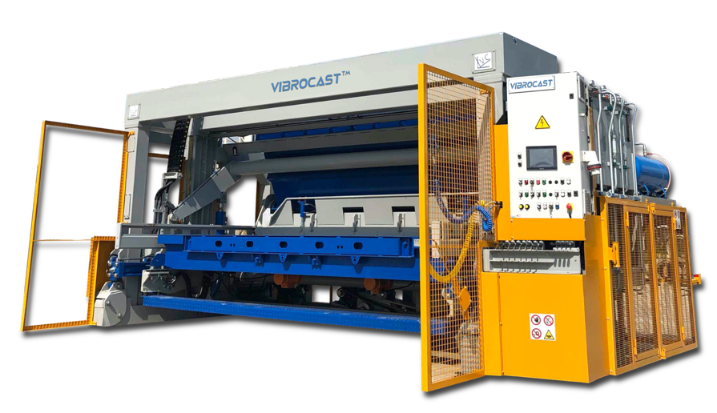

VibroCast TM
Vibroforming Machines and molds
for precast concrete elements
CONFIDENTIAL INFORMATION ALL RIGHTS RESERVED
VIBROCAST TM

Slide 2
TECHNOLOGY
What is a vibroforming machine
Designed to serve, built to last
A vibroforming machine is a tilting machine for the production of reinforced and vibrated concrete; the exchangeable molds are tailor made, designed and produced according to the specific requests of our customers.
VibroCast maintains a continuous production cycle with just an operator for the machine and another operator on the forklift to feed the machine with the concrete. This process reduces drastically the labour cost and consequently increases the productivity.
The choice of using excellent components of well-known international brands results in a significant reduction of machine downtime due to breakage or difficulties in finding availability of spare parts on the market.
How does it work
The machine is easy-to-use, reliable and provides a high production capacity. VibroCast machines are characterised by high frequency vibration technology. This particular vibration, obtained by installing the vibrators directly at the base of the molds, is extremely effective and the concrete is smoothly compacted presenting a high mechanical strength. Once the cycle is finished, the machine rotates the mold (180°) and releases the vibrated concrete element on the ground.

Slide 3
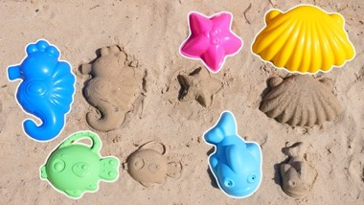
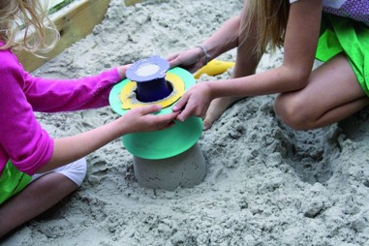
TEChnology
Basically…
The production system is very similar and comparable to a system that we all know.
Who has never played with molds and sand at the seaside?
Small basic tips
With this technology it is important to find the right compromise between sand and water... (our slump).
The water/sand ratio must be correct otherwise you will have shapes that will collapse on themselves if too dry or even remain inside the mold because they are too wet.
VibroCast technology works in a very similar way and is closely linked to the W/C ratio of the concrete mix design.

Slide 4
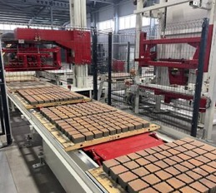
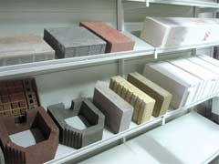
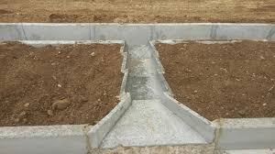
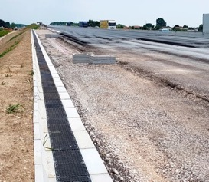
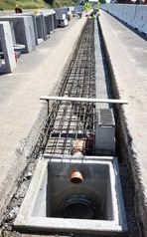

technology
Which type of concrete elements can it makes?
In general it can be said that we are able to produce everything that cannot be produced with vibropresses such as Masa, Hess, Zenith, Quadra, etc...
Incorrectly, our technology is also called vibropress in English but this is not correct.
The correct name is vibroforming machine.
Type of products that can be created
VibroCast technology is highly recommended to all concrete producers who create prefabricated concrete elements for the construction of infrastructures.
Main applications for these products
For every km of road or motorway, there are thousands of prefabricated elements whose existence no one knows; for example New Jersey barriers, roadside channels for drainage, covers, wells for lighting, bases for light poles, roof tiles for slopes, etc...

Slide 5
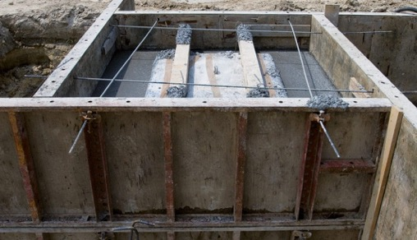
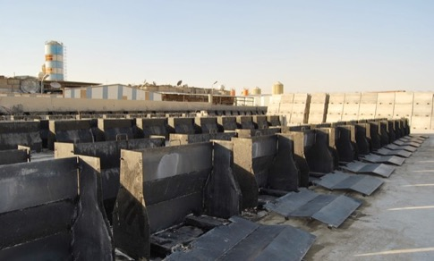
Vibrocast technology vs standard production
How every precast element is produced WITHOUT VibroCast technology?
All over the world, small and medium precast elements are produced on site (cast on site) or with a mold series placed on the ground.
Cast on site
Mold series

Slide 6
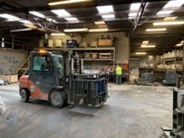
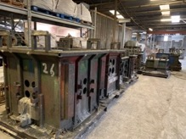
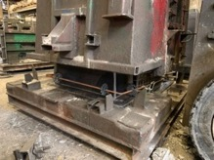
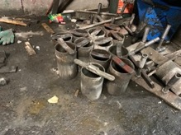
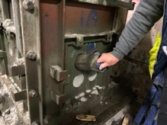
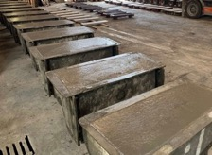
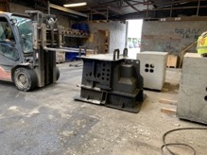
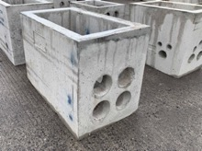
Vibrocast technology vs standard production
But how are these products produced conventionally?
Prepare the area positioning the molds
Dedicated area for the molds
Clean, oil and insert the steel cage in every single mold
Prepare every single component
Positioning every single component
Pour and vibrate the concrete one by one
After curing, open every single mold
Finally
…all these operations only for one type of product

Slide 7
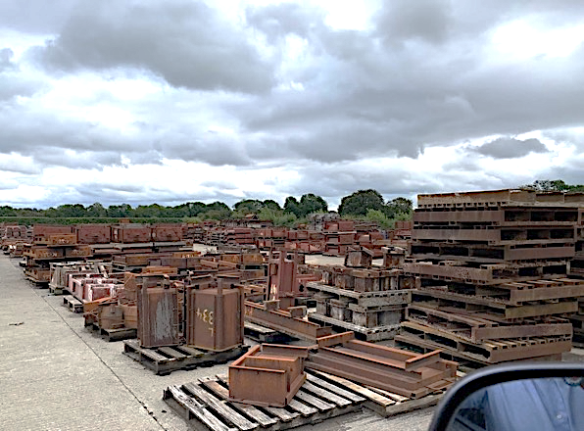
What does all this translate into?
- Huge stock of metal molds for every single product
- High number of manpower employed
- Low productivity
- Less margin
- Less flexibility
- Higher costs
- High maintenance
- Higher risk of injuries

Slide 8
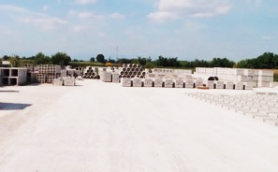
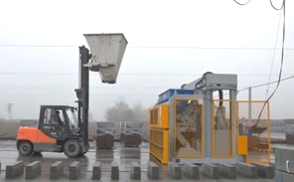
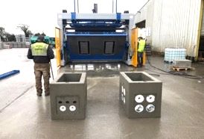
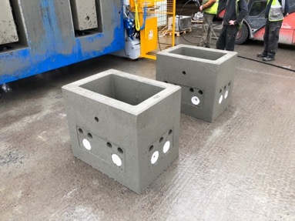
…and using vibrocast?
What is required to start producing with our technology?
Flat floor
Forklift with bucket
n.1 operator
Huge productivity

Slide 9
Advantages of VibroCast technology
HIGH PRODUCTIVITY
LIMITED PRODUCTION AREA
High output, reduced number of operators needed, shortest execution time and excellent finishing quality of the concrete product. This is the perfect mix well appreciated by all of our customer.
This system allows to operate on a considerably smaller surface compared with the traditional production “cast in situ” and is the ideal solution for companies working in small production areas where the cost of land is high.
REDUCED MANPOWER
VERSATILITY
Only an operator is required to menage the vibroforming machine along with another one in charge of feeding the concrete with the forklift directly from the batching plant and handling cured elements.
The whole range of machines can be provided in mobile version and it is simply requested a flat area in order to start operations. No additional work of civil engineer is required to operate the machine.
FAST CHANGE OF PRODUCTION
USERFRIENDLY EQUIPMENT
The mold can be changed in a lapse of time ranging from 15’ to 20’ thanks to the “quick coupling” system, avoiding the use of tools and oil leakage on the floor.
No special training needed for the operator of the machine, the working system is simple to learn and use..

Slide 10
Advantages of VibroCast technology
RELIABILITY
MOLDS
Maintenance operations are very limited, thanks to the choice of high durable components and simplicity of our machines.
All our molds are tailor made and produced upon specific request of the customer.
LOW INVESTEMENT
HIGH MECHANICAL STRENGHT OF THE CONCRETE
Comparing with the conventional way of working that uses a high number of wet cast molds and manpower to make concrete elements of the same quality level, VibroCast technology results very fast in terms of ROI.
This immediate demolding system involves the use of a concrete at low water/cement ratio (e/c < 0,40%) which easily allows the achievement of Rck of 50 – 60 Mpa.
STEEL REINFORCEMENT IN PRECAST ELEMENTS
COMPLEX MOLDS
All our molds are designed for production of elements with or without reinforcement. It is also possible to use steel fibers or polypropylene as reinforcement.
The peculiarity of our molds is the definitive and ideal answer to customer needs, also for particularly complex molds, finding a perfect compromise between technical solutions and costs.

Slide 11
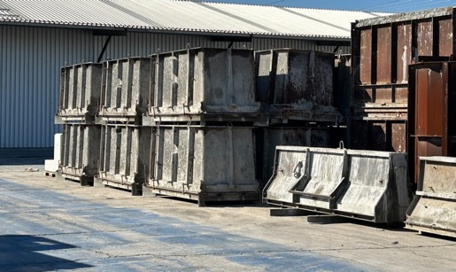

Stock of molds
VibroCast is extremely versatile, in a few minutes it is possible to change the production from one type of element to another one.
Large stocks of battery molds are no longer needed.
The conventional use would require a large area dedicated to the production in several formworks.
VibroCast technology allows a very high production/sqm.

Slide 12
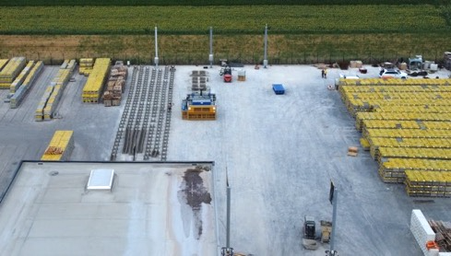
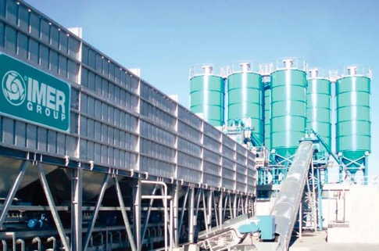
MINIMUM REQUIREMENTS TO PRODUCE WITH VIBROCAST TECHNOLOGY
Straight concrete floor starting from 2,000 sqm
VibroCast machines do not require dedicated runways with ground rails.
They can move freely in all directions and produce wherever there is free space.
Optimal and constant mix design
To maintain consistency in the quality of the products and avoid deformations, it is necessary to have a concrete batching plant that can guarantee quality mixing and that can always carry out correct and constant dosages.

Slide 13
Quality and innovation
Together before, during and after
No limits of application
VibroCast is worldwide present with its sales and after sales network. After the first handshake up to delivery, we follow step by step during the evolutionary path of the product mixing your and our experience in a solution that makes your product unique: a combination of talents. Testing of the installations are made only by high qualified staff, driving step by step the customer toward the perfect result of the final test.
This technology increases the safety, the productivity and the efficiency of your application, ensuring greater comfort and simplicity to daily production. Choosing between the different models of the wide VibroCast range, you can make a tailor made equipment for every typology of production: channels, pipes, curbstones, covers, box culverts for electric cables, boxes for optical fibre, road slab, urban furniture, retaining walls, basement window wells, septic tanks, barriers for car park, cattle slats, light poles, etc… these are only a few examples of possible realizations.

Slide 14

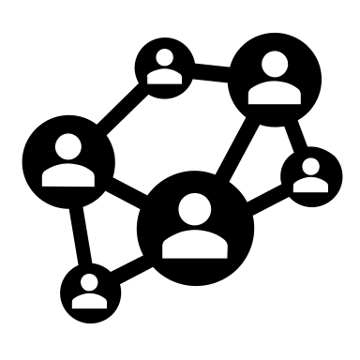
5
WORLDWIDE
CONTINENTI
Everywhere in the world
VibroCast is currently present around the globe in 5 continents.
SALES NETWORK
A network of agents and dealers who operate directly in their own territory are able to guarantee a technical-commercial assistance at 360°.
This is synonymous of confidence for the final customer, aware that can count on a post-sales service quick and efficient.

Slide 15
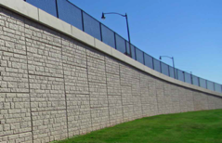
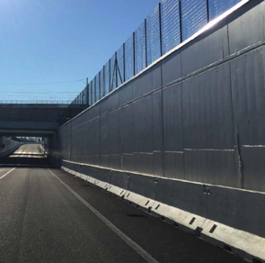
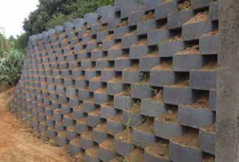
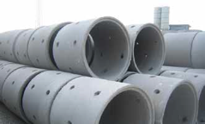
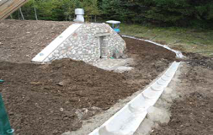
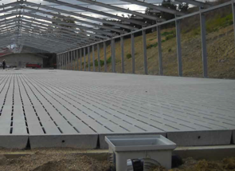
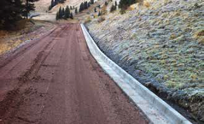

At the service of Infrastructures, public works and much more
Blocks for retaining walls
Interlocking elements for ground containment
New Jersey barriers
Pipes for rainwater drainage
Channels for rainwater drainage
Curb with integrated water drainage
Cattle slats for animals

Slide 16
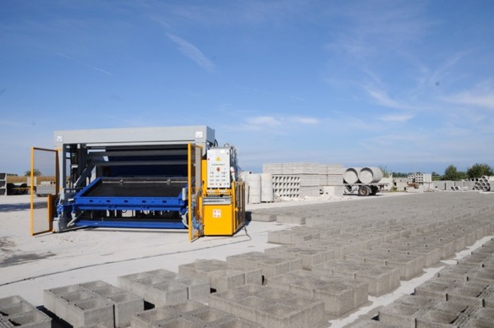
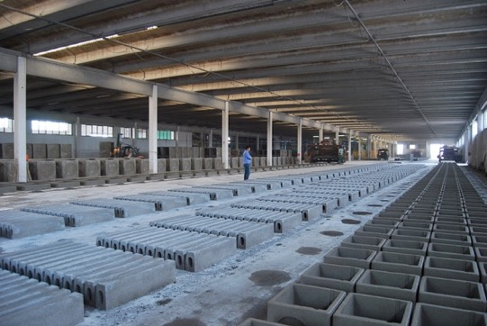
HIGH PRODUCTION CAPACITY
With this technology, a single operator can make the production of 15-20 workers operating in conventional manner with wet cast production in static molds.

Slide 17
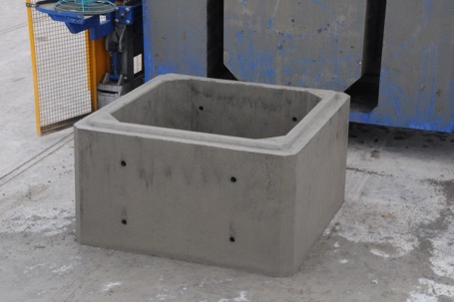

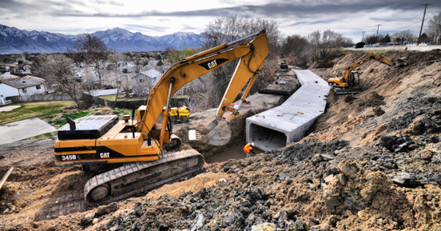
PErformances
Example:
Box culvert 5’ x 5’ H 3’ 4”
n.1 box/cycle
n.6 cycles/hour
n.6 pcs/hour
n.1 operator on the machine + n.1 forklift driver to fill the machine
Theoretical production in a single shift -> n.48 pcs

Slide 18
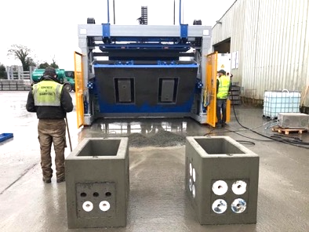
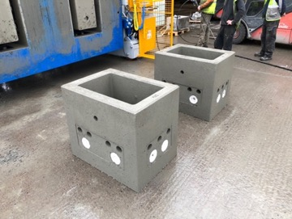
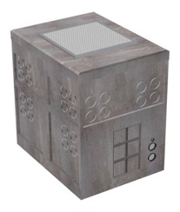
PErformances
Example:
Vault 3’ 7” x 2’ 2” H 2’ 7”
n.2 vaults/cycle
n.10 cycles/hour
n.20 pcs/hour
n.1 operator on the machine + n.1 forklift driver to fill the machine
Theoretical production in a single shift -> n.160 pcs

Slide 19
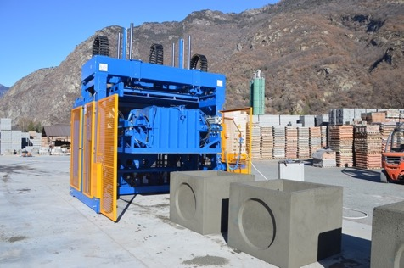
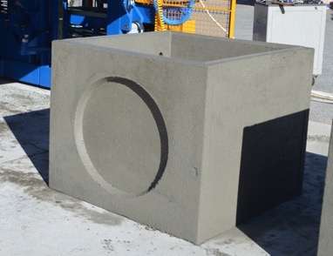
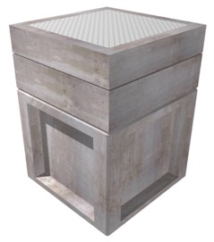
PErformances
Example:
Junction boxes 3’ 7” x 3’ 7” H 3’ 7”
n.2 JB/cycle
n.10 cycles/hour
n.20 pcs/hour
n.1 operator on the machine + n.1 forklift driver to fill the machine
Theoretical production in a single shift -> n.160 pcs

Slide 20
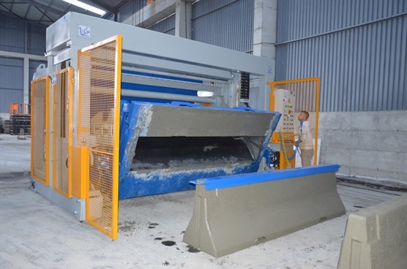
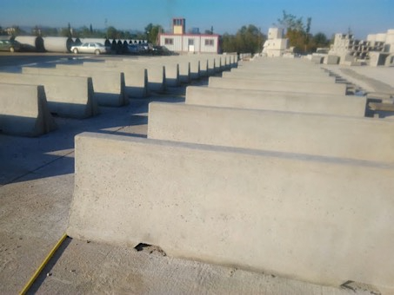
PErformances
Example:
New Jersey barrier 10’ H 3’ 4”
n.1 NJ/cycle
n.12 cycles/hour
n.12 pcs/hour
n.1 operator on the machine + n.1 forklift driver to fill the machine
Theoretical production in a single shift -> n.96 pcs -> around 1.000 linear ft

Slide 21























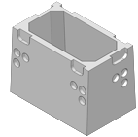












DIVERSIFICATION IN PRODUCTION
The experience gained over the years has made it possible to satisfy all the particular needs required in the various markets.
The molds are always customized and the construction quality that has always distinguished us allow to obtain mass production in continuous demolding.

Slide 22
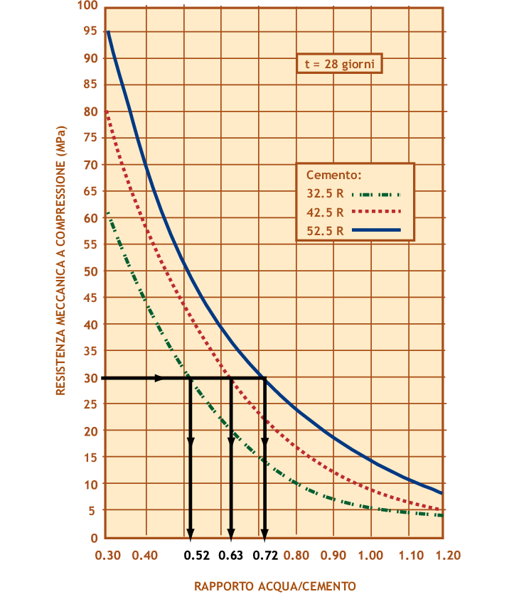
HIGH MECHANICAL STRENGTH OF THE CONCRETE
The technology used provides a significant increase of mechanical strength and quality of the product manufactured working with semi dry concrete (A/C=0,40) compared with conventional wet cast system (A/C=0,50)

Slide 23
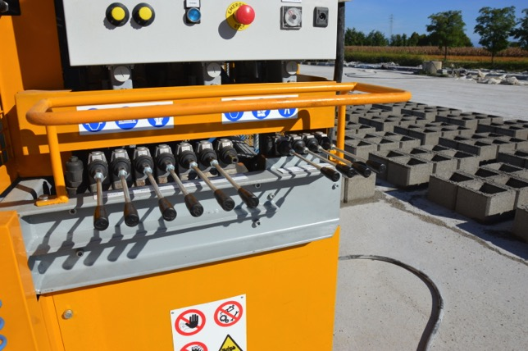
USER FRIENDLY
All machines are semi-automatic
Main advantaged:
easy-to-use
personnel interchangeability
immediate solution of the problems
Simple handling by non-specialized personnel
These are characteristics more and more appreciated by our customers.

Slide 24
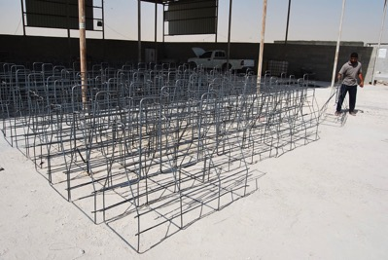



STEEL REINFORCEMENTS
On all our molds it is possible to insert steel cages into the concrete or, in alternative steel or polypropylene fibers.
The insertion of the reinforcement is facilitated by molds with hydraulic opening.

Slide 25

PRODUCTION AREA
VibroCast machines do not require any specific foundation.
To start up the production it is sufficient a flat area and a small batching plant to feed continuously the machine.
Usually, the machine is fed by a forklift.
An area of 4000 mq is sufficient for two days of production.

Slide 26








Technical FEATURES
Heavy reinforced steel structure
Double adjustable hydraulic actuators
Separate hydraulic circuit for machine and mold
Front/Rear adjustable hydraulic actuators
Reinforced frame with increased thicknesses for optimal resistance to vibrations and mechanical stress.
All machines are equipped with double adjustable hydraulic actuators for the rotation.
This system allows the production of elements with big dimensions
Separate hydraulic circuit for machine and mold for a separate control of pressures
Thanks to this system the mold lifts parallel to the floor fundamental in the demolding of big box culverts and big elements in general
Replaceable consumable parts
PLC for machine operations and consumption optimization
Demolding oil system
Round and welded internal chamfers
All the consumable parts, such as drawer guides, anti-wear plate and wheels are easily replaceable thanks to screwed inserts
All machines are equipped with a PLC for the optimization of consumption and the general management of the machine.
The demolding oil system, composed of a compressor, an oil tank and a suction pump is standard on the whole range
All our molds have round and welded internal chamfers. This peculiarity keeps the quality of execution of the elements produced unchanged over time.

Slide 27











Technical FEATURES
Inverter for the management up to 4 vibrators
High quality components
Separate hydraulic openings for the molds
Fast connections to the control panel
All machines are equipped with n.3 inverters for motor/main pump management and control of up to four motor vibrators for molds
The choice of using excellent components with high availability on the market, guarantees to the customer a fast maintenance resulting in time savings on machine downtime.
All machines are equipped with n.4 distributors for the hydraulic movement of the molds. This allows the use of special molds with complex hydraulic openings
Control panels are connected to the machine through HARTING connectors. Fast maintenance thanks to quick removal of the control cabinet
“Quick coupling” system between machine and mold
Fast and easy front wheels adjustment
Mixer in the drawer
Complete set of tools provided with the machine
Quick-change mold with the "quick coupling system" (Max 15-20 min) avoids the use of tools and, above all, the undesired loss of oil on the floor.
The front wheels are hydraulically adjustable by a specific lever placed under the control panel.
(starting from model VC 200 N)
The mixer in the drawer accelerates the filling of the molds increasing the productivity.
A complete kit of WÜRTH tools for the ordinary maintenance is provided along with the machine.

Slide 28








Technical FEATURES
10” touch screen monitor
Bronze-aluminum bushes
Automatic lubrication system
Tele-assistance service
The 10“ touch screen monitor allows the operator to have all the machine processes under control
All the joints on the levers are fitted with bronze-aluminum bushes for a longer lifetime of all moving parts
The kit frees the operator from routine maintenance, keeping all moving parts of the machine automatically lubricated
Machine downtime drastically reduced thanks to the after sales service of tele-assistance.
Rack work system for big elements
Hydraulic hooks for steel plates
Advanced control system
Advanced safety system
Thanks to this option it is possible to produce elements with a width up to 2500 mm
Hydraulic hooks installed directly on the rotation arms for use of universal plates.
For some models there is the possibility of interacting with the machine through an advanced control system.
Safety equipment such as photocells, advanced laser-scans allow to operate in total safety

Slide 29
innovative technology in the precast sector
A technology that constantly pursues innovation based on continuous listening to customer needs. We have grown constantly without losing our DNA as a lean and flexible structure, ready to redesign its organizational logic to quickly design and propose unique and innovative proposals, in line with the needs of a market that is changing with increasing rapidity.
VibroCast is able to offer a variety of value-added proposals to support the customer in the realization of his projects, even those of considerable technical complexity.
OUR NUMBERS
100+
600+
5 continents
10+
Plants in the World
Annual projects
Worldwide presence
Years of experience

Slide 30



HOW WE WORK
OUR TARGET
OUR TOOLS
360 degree customer view
Development of customer project
FULL SUPPORT for:
Productivity increase
Analysing Customer needs
Identifying the possibilities
Presenting the dedicated solution
WHERE WE ARE
Designing
Production
Test and commissioning of the equipment
In ITALY and WORLDWIDE
In any Country in the world

Slide 31
Quality and innovation
A winning team
Designed to serve, built to last
VibroCastTM, registered trademark property of Expomat s.r.l., was created on 2015 proposing on the market vibroforming machines technologically more advanced compared with the ones existing up to that moment. Leader trademark in the sector of the prefabrication, in these years has always demonstrated to be up with new challenges, understanding real needs of the customer and offering tailor made solutions. VibroCast is, above all, a team. A combination of different people putting together their talent to win producing innovation and discovering every day opportunities for improving in quality and designing.
VibroCast trademark stands out for its great reliability and high quality level of materials used, result of a constant work of research and testing. The whole range of vibroforming machines is equipped with excellent components manufactured by worldwide leading companies ensuring a long life and efficiency during the lifetime of the machine.

Slide 32


Slide 33



